Slide 1
April 1, 2020
Open Hours:
2020 Business Meeting of the General Assembly

Slide 2
Planned Agenda
[ITEM A] 16:30 Welcoming remarks (John Chodacki, Board President) followed by five presentations that will require member voting/approval via online portal
[ITEM B] 16.40 Present the 2019 Annual Report (Matt Buys, Executive Director)
[ITEM C] 16.50 Present minutes from 2019 General Assembly (Britta Dreyer, Business Manager)
[ITEM D] 16:55 Present Financial Report and 2020 Budget (Marco Marsella, Treasurer)
[ITEM E] 17:05 Present the Membership Model and Fees (Matt Buys, Executive Director)
[ITEM F] 17:15 Present Executive Board Nominations (John Chodacki, Board President)
[ITEM G] 17:20 Voting results (John Chodacki, Board President) Voting will close at 17:20 CEST.

Slide 3
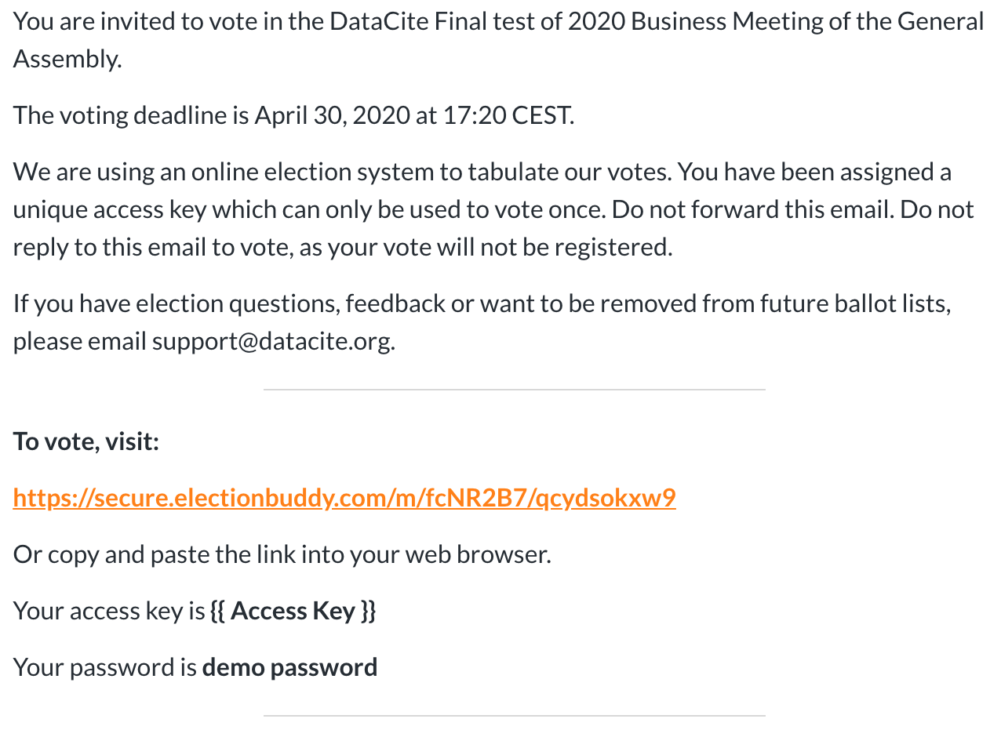
Voting process
Step 1: Voting contacts in Fabrica will receive secure access details on April 23, 2020 at 16:30 CEST

Slide 4
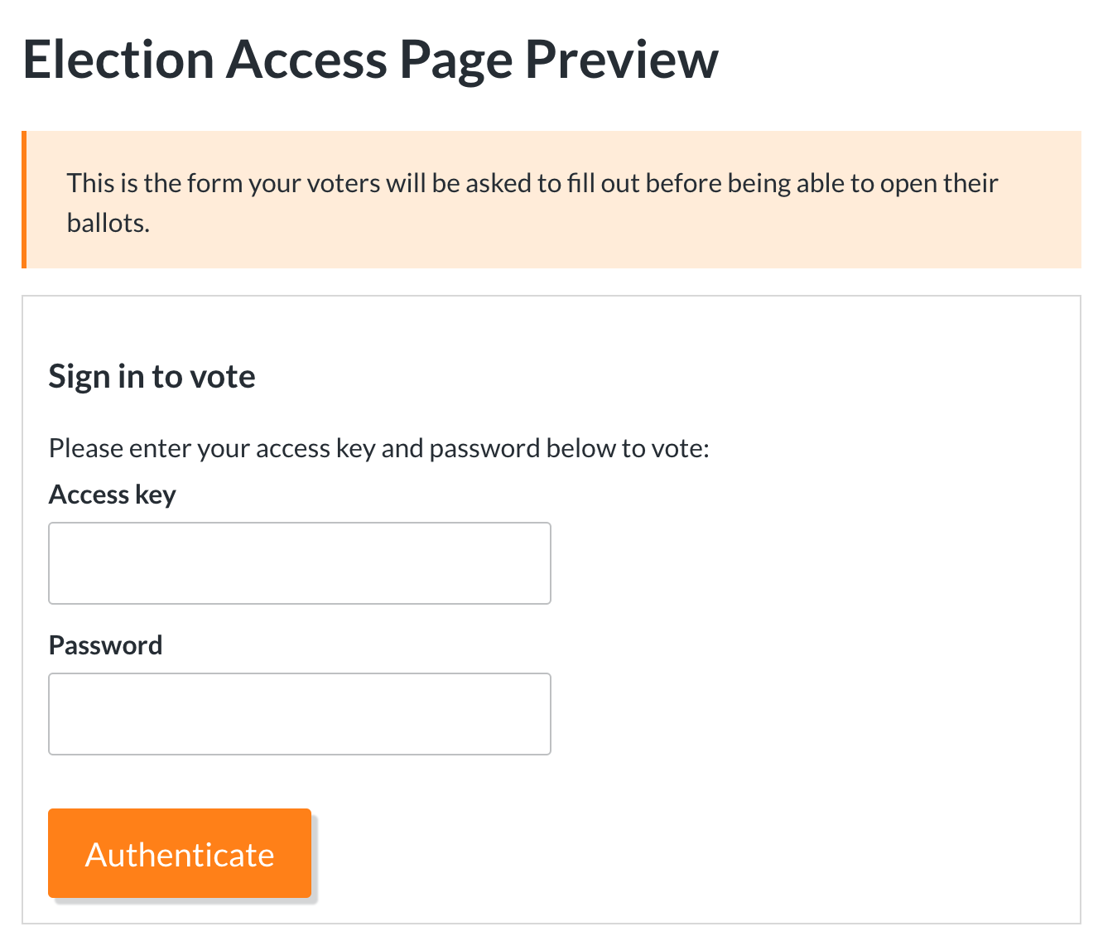
Voting process (cont.)
Step 2: Enter unique access key and password

Slide 5
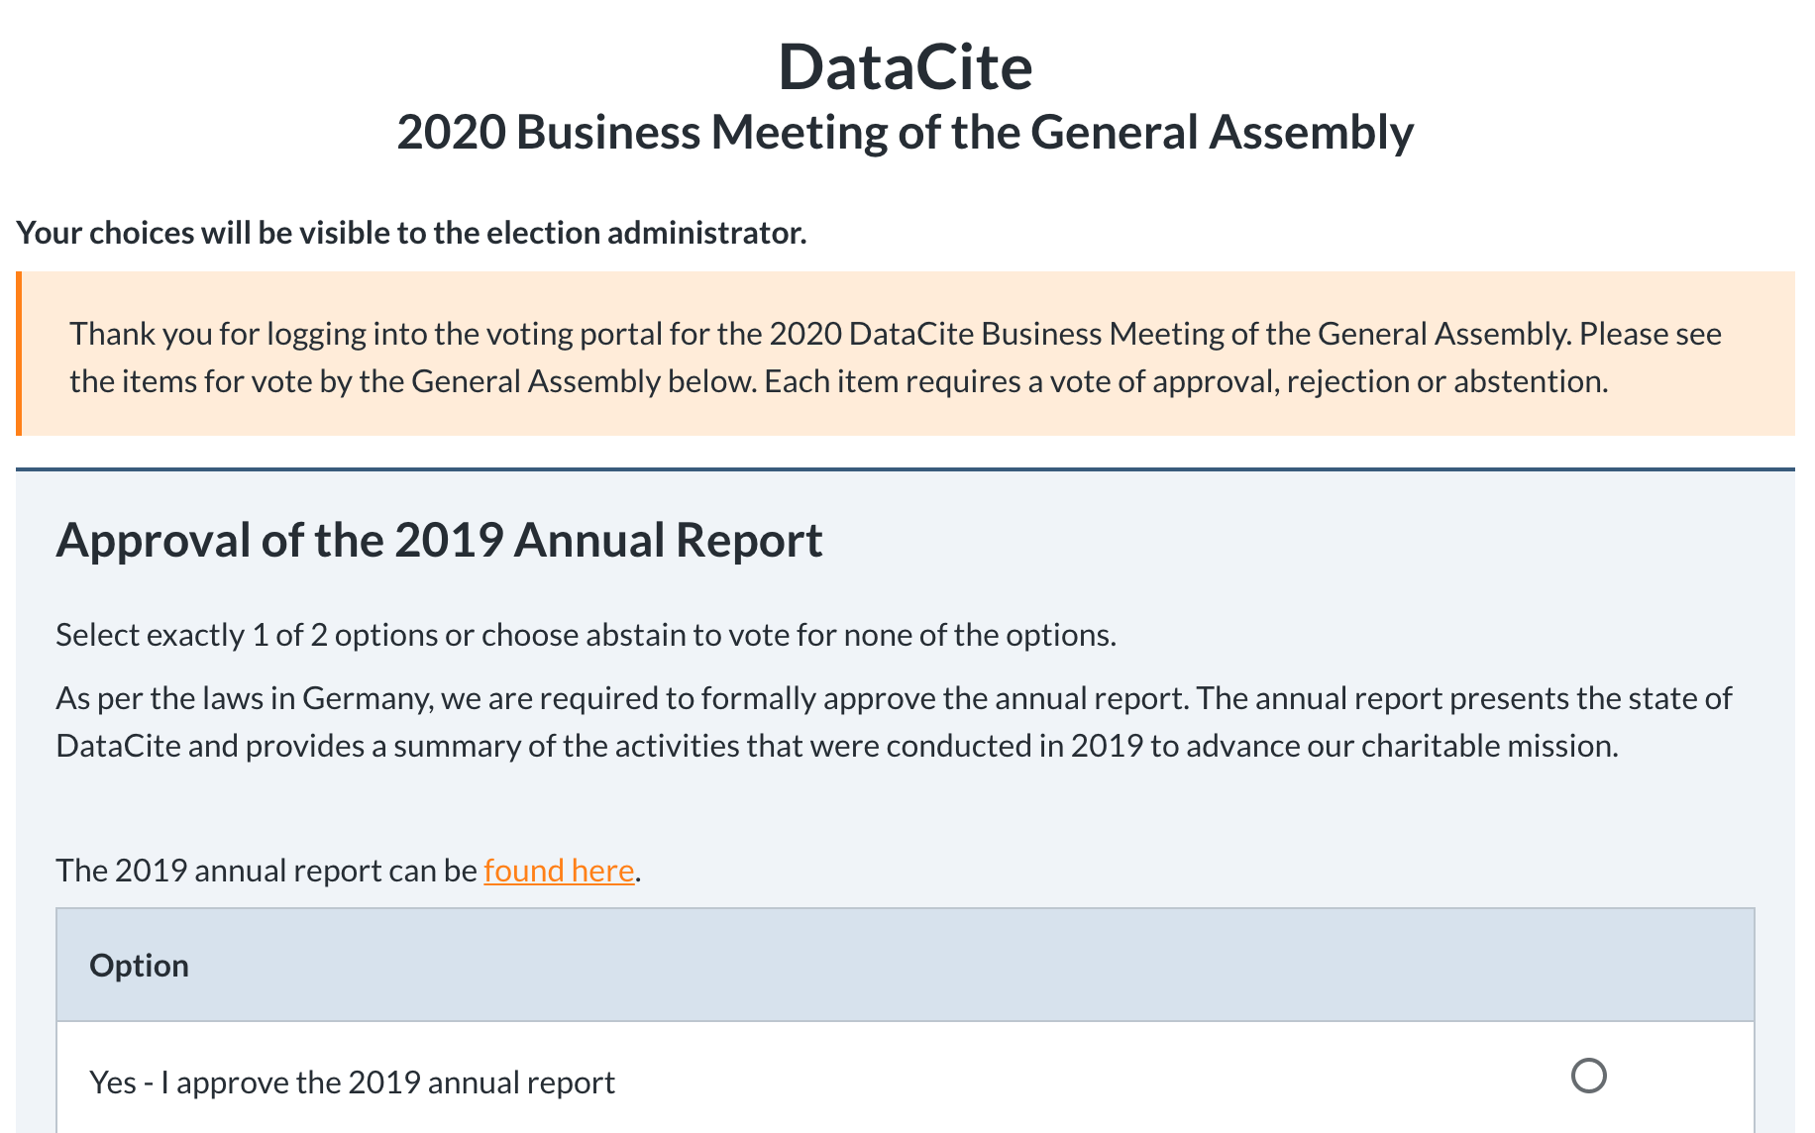
Voting process (cont.)
Step 3: Follow the onscreen prompts

Slide 6
Motions and results
There are seven (7) motions that will need to be voted on during the 2020 Business Meeting of the General Assembly:
Approval of the 2019 Annual Report
Approve the 2019 General Assembly minutes
Approve the 2020 Annual Budget
Approve the application of the 2019 reserves
Approve the Membership Fees for 2020
Approve the Membership Model & Fee adjustment
2020 Executive Board Elections
Each motion includes the specific details and links to related materials. The results will be presented during the meeting on April 30, 2020 at 17:20 CEST.

Slide 7

Are there any questions about the 2020 Business Meeting of the General Assembly or voting process?

